Slide 1


Obstacle Avoiding Car
Final project
By:
Omar Kamel
Farida Abaza
Omar Hesham

Slide 2
1. introduction
Modern Automation
- Most Manufacturers are transitioning into producing autonomous vehicles that fully carries out the driving operation eliminating the need to a human driver.
Advantages of autonomous vehicles:
- High Efficiency and relevance.
- More accurate and precise.
Disadvantages of Autonomous vehicles:
- Complicated.
- Expensive.
Notes:
Automated vehicles:
More efficient, carries out the tasks efficiently as programmed to.
More accurate, eliminates human error.
Relevant
Cons:
Complicated
Expensive

Slide 3
A brief about the project
Automated vehicle that is programmed to detect obstacles, using Ultrasonic sensor, and maneuvers around them.
The vehicle would detect the obstacles based on a predetermined and programmed threshold distance.
- After obstacle detection, the vehicle would change its direction to a relatively open path by making autonomous decision.

Slide 4
2. Components
Microcontroller Atmega32.
Ultrasonic HC – SR04.
Servo motor SG90.
L293D.
Motors.
Chassis.
Batteries.

Slide 5
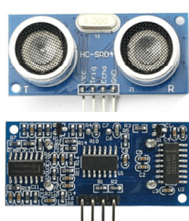
Ultrasonic sensor
What is Ultrasonic sensor?
An Ultrasonic sensor is a device that can measure the distance to an object by using sound waves.
Features:
Power Supply: +5V DC.
Working Current: 15mA.
Ranging distance: 2 cm – 400 cm.
Dimension: 45mm x 20mm x 15mm
Notes:
Ultrasonic sensors are sensors that convert ultrasound waves to electrical signals or vice versa.
An Ultrasonic sensor is a device that can measure the distance to an object by using sound waves.

Slide 6
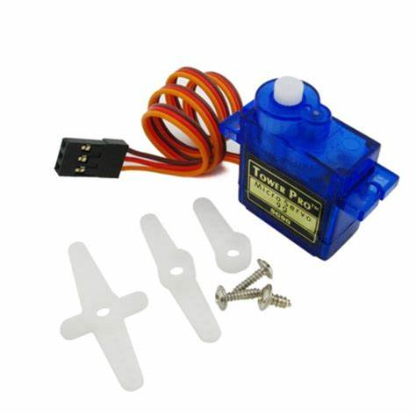
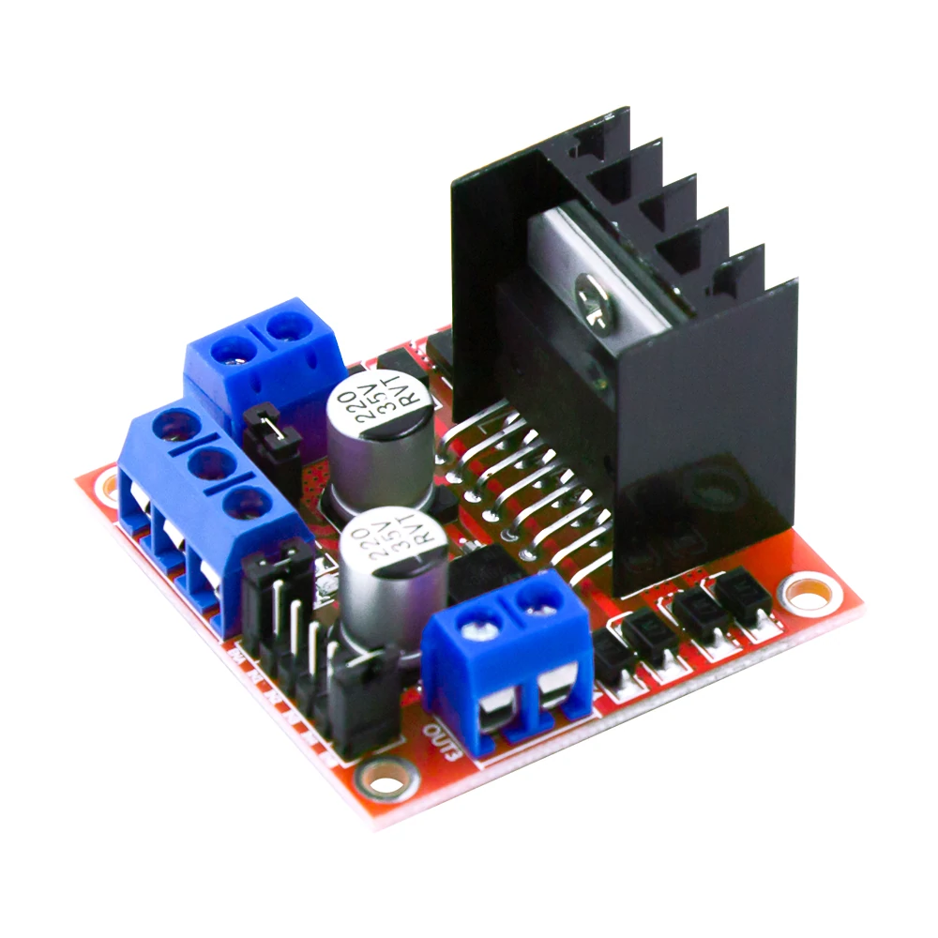
Servo Motor SG90
A simple servo motor that can rotate 90 degrees in both directions.
L298N Motor drivers
Motor driver that provides bi-directional current to the motors.

Slide 7
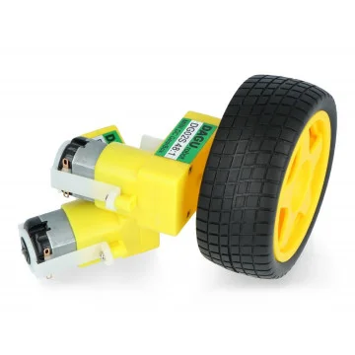
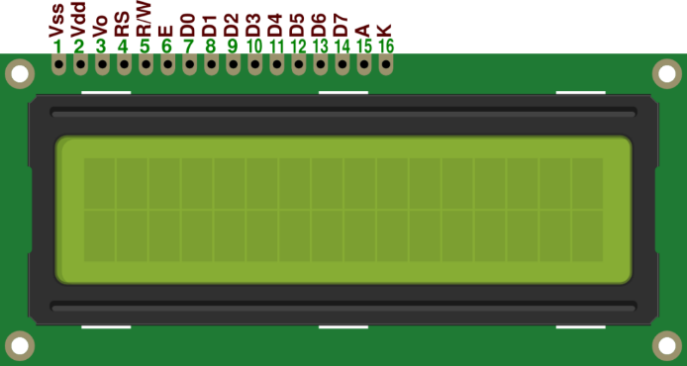
DC motors
Controlled by the drivers and provides movement to the vehicle.
16x2 LCD
Liquid Crystal Display for displaying sensor readings and relevant data.

Slide 8
Chassis
Vehicle body and wheels where the hardware components including the motors, sensors and microcontroller will be bolted to.
Battery
Power source for the robot (motors and sensors).

Slide 9
3. Operation
The robot vehicle uses the Ultrasonic Distance Sensor to measure the distance in front of it
When this distance reduces to a, pre-determined level, the robot interprets the presence of an obstacle.
The robot stops, goes backwards and looks left and right.
The Robot then turns to the direction that shows more free space.

